Slide 1

Ribonucleic acid Structure
Shuzan Ali Mohammed, MD
Lecturer of Medical Biochemistry
Shuzan.ali@fmed.bu.edu.eg
http://www.bu.edu.eg/staff/shuzanali12
Shuzan Ali

Slide 2
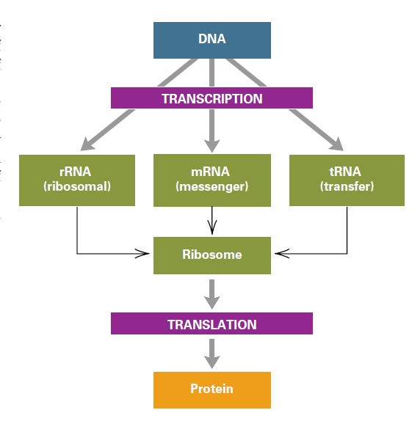
snRNA
80%
5%
15%

Slide 3
Difference | DNA | RNA
Name | Deoxy-ribo-nucleic a | Ribo-nucleic a
Sugar | Deoxyribose | Ribose
Strand | Double | Single
*Bases | A, G, C, T | A, G, C, U
Types | One type | Several
**Main Site | Nucleus | Cytoplasm
Shape | Double helix | Variable
Synthesis | By replication | By transcription
***Function | Carries genetic information | Protein synthesis
* tRNA contains thymidine
** Mitochodrial DNA is present in mitochondria
** snRNA is present in the nucleus
*** Some viruses contain RNA as their genetic material.

Slide 4
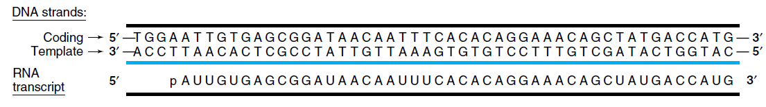
1. mRNA
3'
5'
3'
s

Slide 5
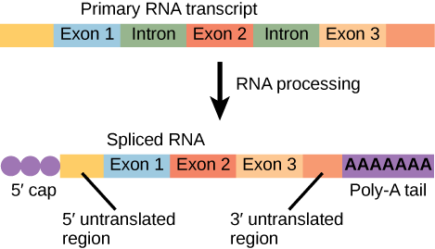
7- methyl GTP cap
5' UTR
3' UTR
poly A tail
Exon
Exon
1. mRNA
Complement. to DNA templete
Each 3 bases form 1 codon
5' end
3' end
*
*
*
* Exons; coding but Introns (non coding) are present only in 1ry transcript.

Slide 6
2. rRNA
*associates with several ptns →ribosomes
Eukaryotic ribosome (80 S)
60 S subunit
40 S subunit
3 rRNAs
(5, 5.8, 28 S)
50 polypeptides
35 polypeptides
one rRNA ((18 S
Eu (5, 5.8, 18, 28S)
2 nucleoprotein subunits
60 S & 40 S 80 S (full ribosomal subunit)
S= Svedberg unit; the unit that measures the sedimentation velocity of different particles depending on their molecular weight by using high speed centrifuge.

Slide 7
2. rRNA
*associates with several ptns →ribosomes
Prokaryotic ribosome (70 S)
50 S subunit
30 S subunit
2 rRNAs
(5 and 23 S)
34 polypeptides
21 polypeptides
one rRNA ((16 S
Pro (5, 16, 23S)
2 nucleoprotein subunits
50 S & 30 S 70 S (full ribosomal subunit)
S= Svedberg unit; the unit that measures the sedimentation velocity of different particles depending on their molecular weight by using high speed centrifuge.

Slide 8
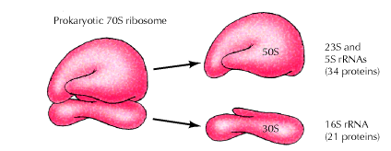
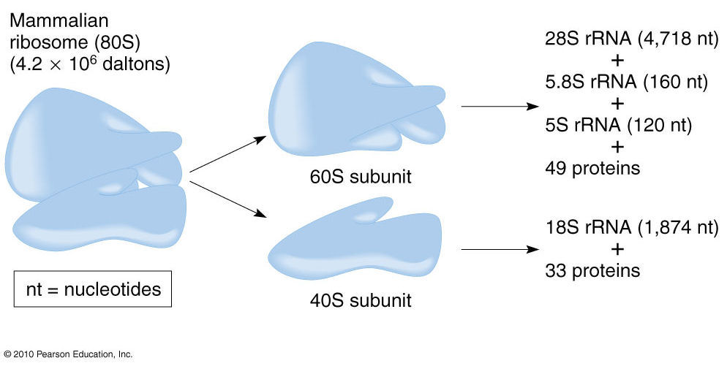
Vh
Bnn
,.l
jj
a
h

Slide 9
3. tRNA
70-90 nucleotides, carries aa during translation
SS folded→cloverleaf acceptor arm & 4 loops;
*Anti-codon loop, *dihydro-uracil (DHU) loop,
*Thymidine pseudouridine cytosine (TΨC) loop & *extra-loop.
CCA 3'end Acceptor arm carries aa.
at least 20 tRNAs; at least one corresponding to each aa.
Anticodon loop: 3 bases; anticodon
complementary basepair with mRNA codon.
Unusual bases [dihydrouracil (DHU),
pseudouridine (Ψ) &
thymine (T)]

Slide 10
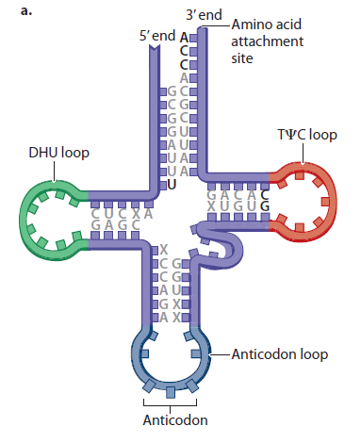
tRNA
Acceptor arm
Extra loop

Slide 11
*performs structural & catalytic function in posttranscriptional modifiation of mRNA (splicing).
4. snRNA

Slide 12
Viral nucleic acid
Difference | DNA viruses | RNA viruses
Nucleic acid | DNA | RNA
Strand | Single or double | Single or double
Example | HBV | HIV, influenza, HCV
Replication | DNA polymerase | RNA polymerase
Proofreading activity | Yes | No
Liability to Mutations | Less | More
Vaccine | Can be prepared | Difficult to prepare (change their structures continuously)
Proofreading activity: correction of wrong base

Slide 13
Gene expression
The gene (DNA) undergoing transcription into mRNA that translate the encoded genetic information into protein
Transcription (RNA synthesis)
By DNA – dependent RNA polymerase (using DNA as a template)
Features of transcription:
*One of 2 DNA strands is transcribed (template or anti-sense).
(templete strand sequence is complement. to mRNA transcriped).
* The other strand (non-transcribed); (coding or sense); has the same sequence as the synthesized RNA (except T →U)
* DNA template strand is read in 3' to 5' direction by RNA polymerase & RNA is synthesized in 5' to 3' direction.
* A transcriptional unit is the segment of DNA between specific initiation & termination sequences (produces 1^{ry} transcript).

Slide 14
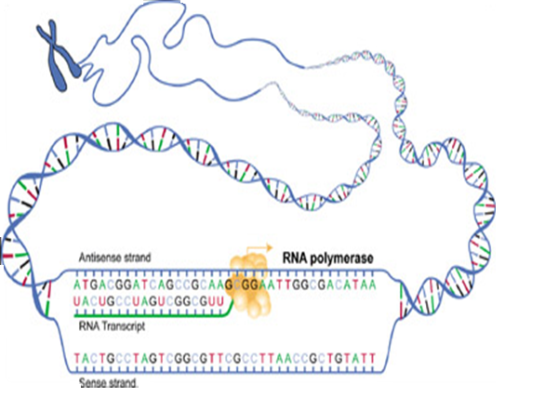
(Template)
(Coding)

Slide 15
Replication Versus Transcription
Point | Replication | Transcription
Definition | Synthesis of DNA | Synthesis of RNA
Gene copied | Both strands are replicated (All genes) | Only the template strand is transcriped (Selected genes)
Polymerase | DNA polymerase | RNA polymerase
Primer | Need a primer | No primer
Proofreading | Present | Absent
Postsynthesis modification | Limited (only methylation) | Numerous mRNA: cap, tail, splicing rRNA: subunit format. (40S & 60S) tRNA: removal of 5' leader sequence Addition of 3' CCA Chemical alteration of bases Excision of intron in anticodon loop

Slide 16
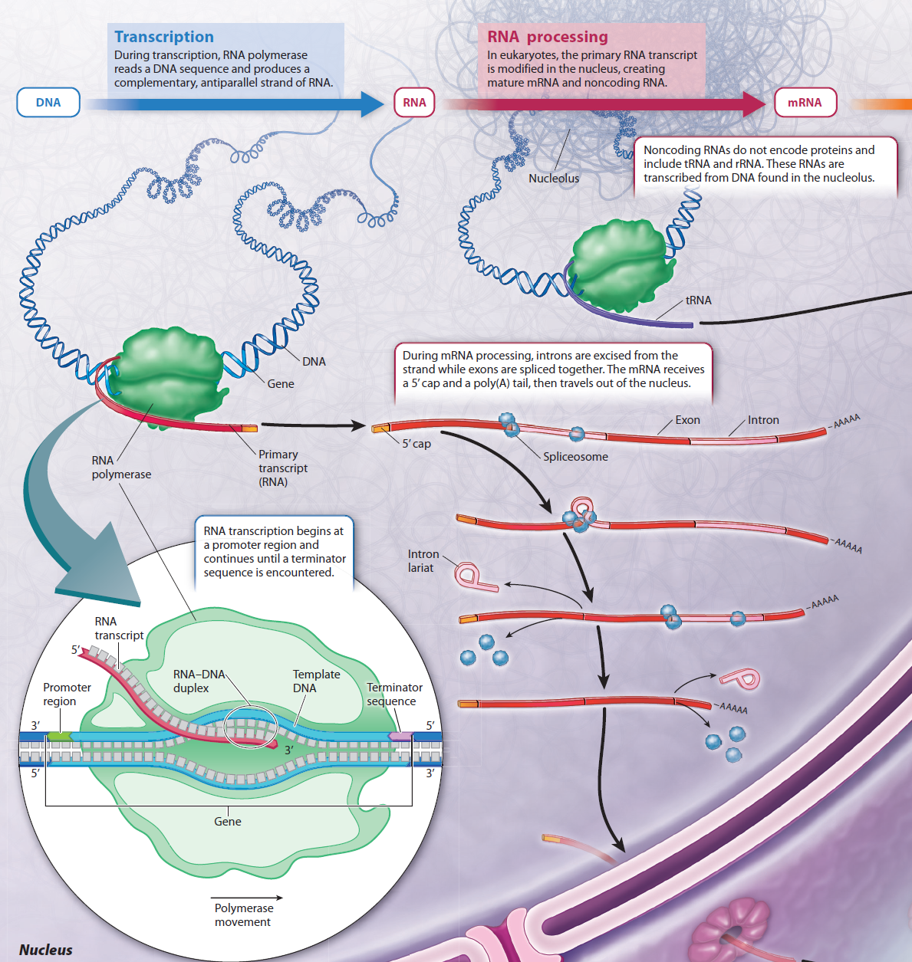

Slide 17
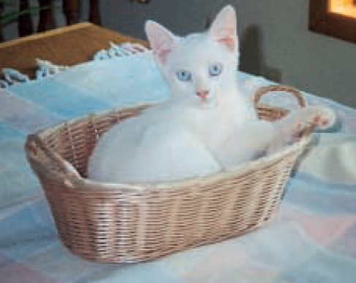
thank you
Shuzan Ali
4/10/2016 7:34 AM
shuzan.ali@fmed.bu.edu.eg
17

